Slide 1

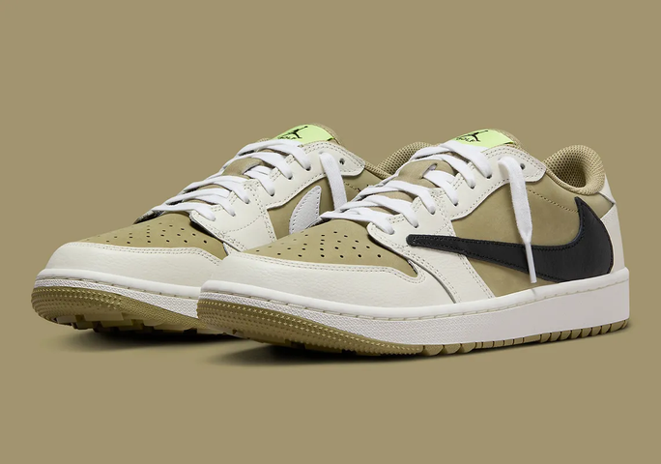

SEATWORK 6.1 EXPLATORY DATA ANALYSIS ON YOUR OWN DATA SET
CPE22S3
NIKE SHOES SALES
This dataset can gain insight into which Nike shoes are most popular among consumers
CPE 311:
COMPUTATIONAL THINKING WITH PYTHON
PRESENTED BY
John Rome A. Belocora

Slide 2

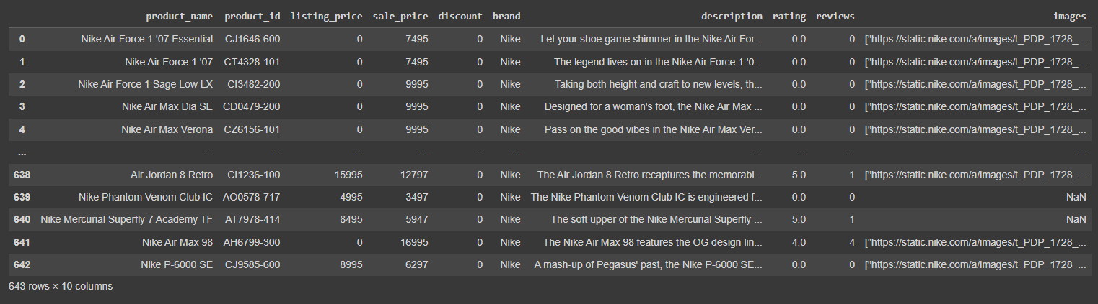
THE DATA SET

Slide 3

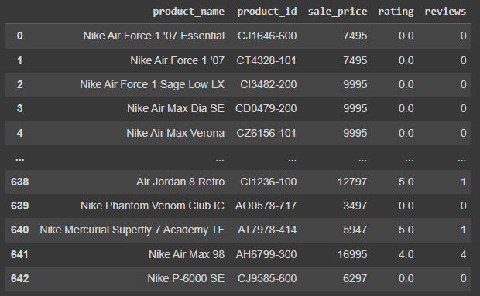

CREATING A DATA FRAME
BASIC DATA
A DATAFRAME THAT HAS THE BASIC OR THE NECESSARY INFORMATIONS OF THE DATA

Slide 4
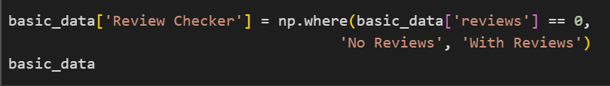
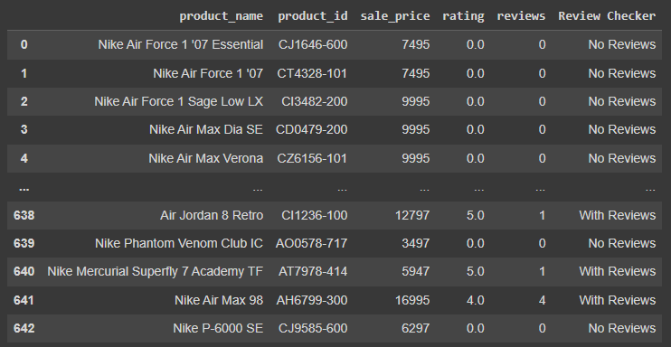
ADDING A NEW COLUMN

Slide 5
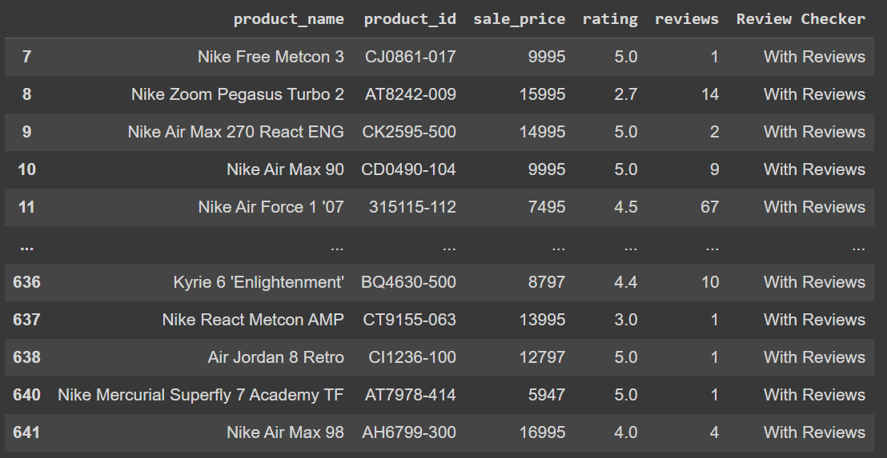
FILTERING ROWS BASED ON THE VALUES
WITH REVIEWS:

Slide 6
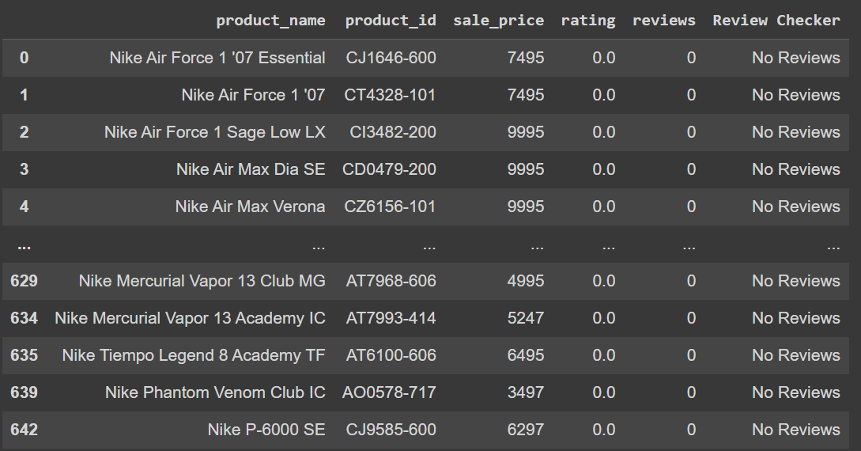
WITHOUT REVIEWS:

Slide 7
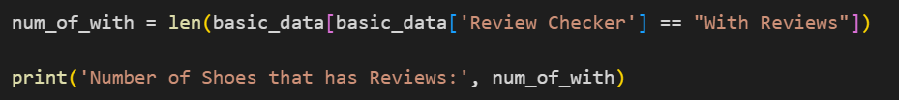
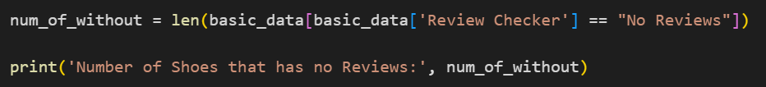
CALCULATING THE RANGE
WITH REVIEWS:
WITHOUT REVIEWS:

Slide 8
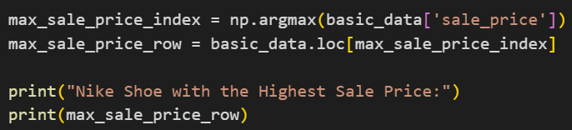
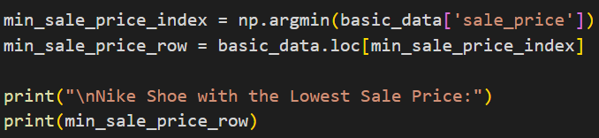
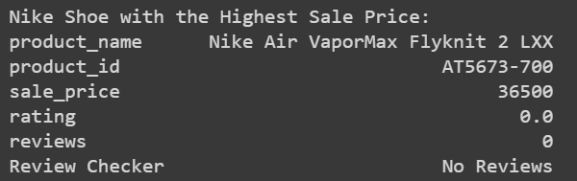
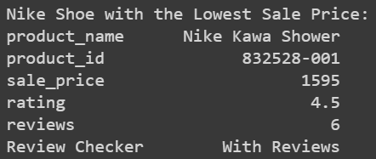
GETTING THE HIGHEST AND LOWEST PRICE
HIGHEST PRICE:
LOWEST PRICE:

Slide 9
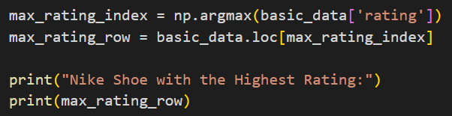
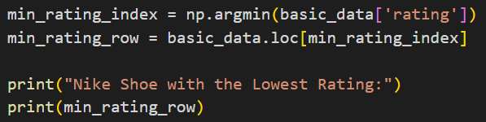
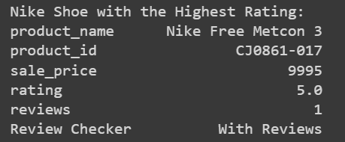
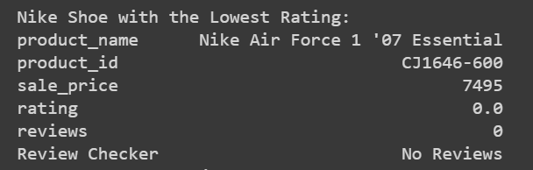
GETTING THE HIGHEST AND LOWEST RATING
HIGHEST RATING:
LOWEST RATING:

Slide 10
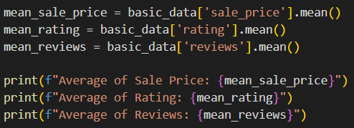
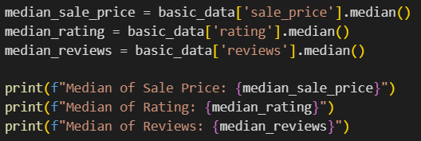


GETTING THE MEAN, MEDIAN, AND MODE
MEAN:
MEDIAN:

Slide 11
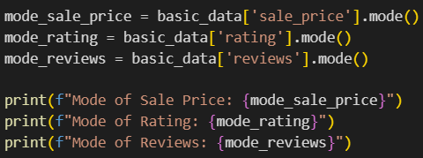
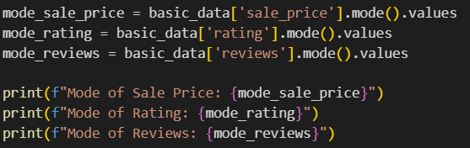
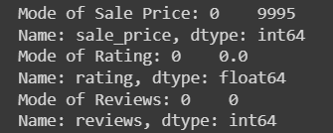

MODE:

Slide 12



THANK YOU
FOR LISTENING

